Slide 1

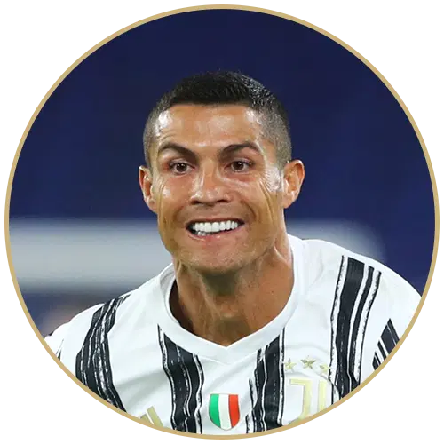
Messi vs. Ronaldo: Through the Lens of Instagram Comments
David Li

Slide 2
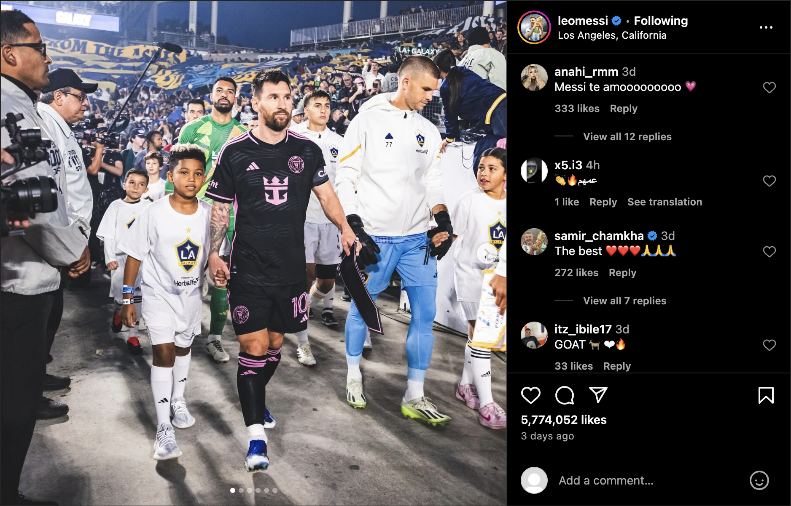
Data Overview
Comments scraped directly from Instagram
Three most recent posts for each athlete
Ronaldo: 2302 rows
Messi: 1809 rows

Slide 3
Comments Containing “GOAT”
Using ‘([Gg][Oo][Aa][Tt]|[Gg].[Oo].[Aa].[Tt].|🐐)’ to match all variations
Number of Comments | 181 | 204
Percentage of Comments | 7.86% | 11.28%

Slide 4
Messi Lives “Rent-Free” in the Heads of Ronaldo Fans
1.43% of comments contains Messi | 7.52% of comments contains Ronaldo

Slide 5
Emoji Sentiment Analysis
Huge amount of emojis within all comments

Slide 6

Calculated Each Emoji’s Sentiment
$$\frac{Positive −Negative}{Occurrences}$$
Emoji | Occurrences | Negative | Neutral | Positive | Sentiment Score
😂 | 14622 | 3614 | 4163 | 6845 | = 0.2209684038

Slide 7
Ronaldo > Messi: Average Emoji Sentiment
Average Sentiment Score | 0.489 | 0.465

Slide 8
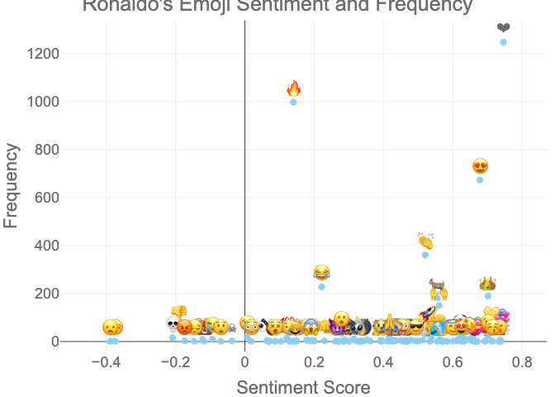
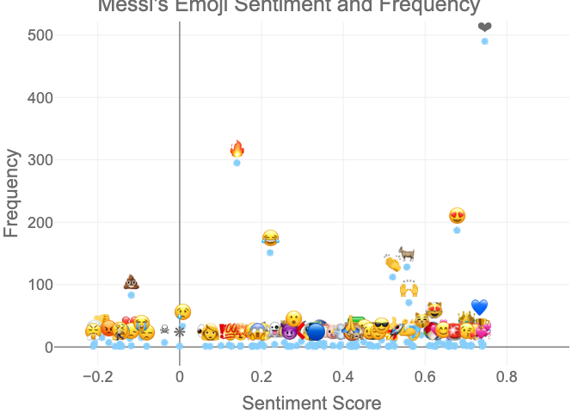
Emoji Frequency

Slide 9
SIUUUU Counter
Using ‘([Ss][Ii]+[Uu]+|[Ss][Uu]+[Ii]+)’ to match all variations
Percentage of SIUU’s in the Comments | 2.52% | 1.71%

Slide 10
Thank you!

